Slide 1
Using Supervised Learning Algorithms to Predict Discontinued Operations in Nonprofit Institutions
Chengzhang Wu, Rutgers Business School
Richard Dull, West Virginia University

Slide 2
Background and Introduction
IRS Form 990 provides various detailed financial and non-financial information about certain non-profit organizations in the United States. For these organizations, this form must be filed annually with Internal Revenue Service. Line 31 on IRS Form 990 asks “Did the organization liquidate, terminate, or dissolve and cease operations?” during the year. If so, additional information must be provided.

Slide 3
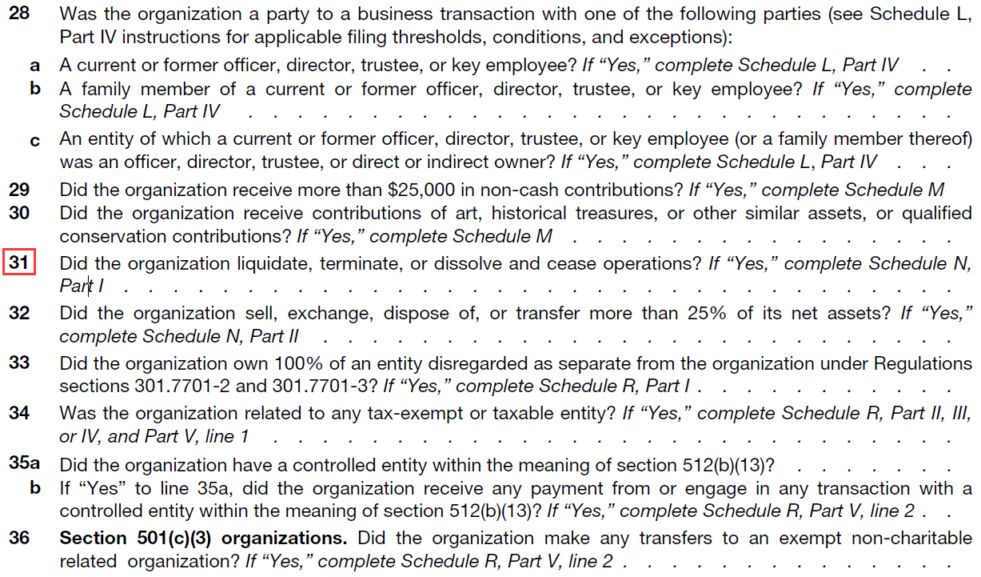

Slide 4
Predicting Factors
Tuckman and Chang (1991) used four financial ratios to define a non-profit organization as “severely at risk” of becoming financially vulnerable.
Four additional sets of financial factors are derived from Ritchie and Kolodinsky (2003)

Slide 5
Predicting Factors
Financial Vulnerability x 4
Fiscal Performance x 6
Fundraising Efficiency x 2
Public Support x 4
Investment Performance and Concentration x 4

Slide 6
Research Questions
RQ1: Which algorithm is accurate for prediction for dissolution of a nonprofit organization.
RQ2：What predictors contribute to these prediction algorithms?
RQ3：Does the application of cost-sensitive algorithms improve the accuracy of the results.

Slide 7
Data and Methodology
This study uses a Form 990 database, which contains all e-filings from 2011 to 2018. Considering the integrity of data, this study uses 2015 data for training purpose and 2016 data for testing purpose.
SQL is used to a query in the Form 990 data to list the all the unique (by tax year and EIN) records that indicated termination of operation and the year of termination. The selected records will be used to train the machine learning model and to test the generalization of the model.

Slide 8
Imbalanced Data Preprocess
The study uses an under-sampling technique to address the imbalanced training set. The training set includes 831 records that indicate discontinued operation in the electronically filed Form 990. The other 831 records that do not indicate discontinued operation are randomly selected from the e-filed population. The final training set used in this study includes 1662 records.

Slide 9
Evaluation Measurement
Predicted Class
True Class | Positive | Negative | Total
Positive | True Positive (TP) | False Negative (FN) | p
Negative | False Positive (FP) | True Negative (TN) | n
Total | p' | n' | N
The ROC space defines the X axis is defined as false positive rate (FPR) and the the Y axis is denifed as true positive rate (TPR). Each classifier with a given class distribution and cost matrix is represented by a point (FP, TP) on the ROC curve. For a model that produces a continuous output TPR and FPR vary as the threshold varies between 0 and 1 (Jin Huang ; C.X. Ling). The resulting curve is called the ROC curve. Given two classifiers, we can say that the one with higher AUC value is better than the other one (Alpaydin, 2014).

Slide 10
Results

Slide 11
Results with cost-sensitive algorithm

Slide 12
Conclusion
Random Forest performs much better among all the ML algorithms compared in this research.
20 predictors working together yields the better results.
The application of cost-sensitive algorithm does not improve the performance of Machine learning model significantly.

